Slide 1
Migrating to ASP.NET 3.1
The basic steps, those must be done
28.01.2020

Slide 2
Migrate or not to Migrate (If you don’t need to migrate to ASP.NET Core, don’t, 4.8 is out)
Migrate to ASP.NET 3.1 if:
Performance is a must (Kestrel delivers 7M requests/sec)
Cross platform support is needed
Multiple applications running on the same server, and different frameworks are used
Your web application is MVC, WebAPI, SignalR
You want to take advantages of C# 8
ASP.NET 3.1: Blazor, Service Worker, Windows Desktop
Do Not Migrate to ASP.NET 3.1 and stay with 4.8 if:
Because the Cool Kids are using it
Just because you heard Containers Containers Containers (4.7.2, 4.8 works great in a windows based container)
Just because you want the Depedency Injection (You can do it in WebForms as well – Unity, Ninject, Autofac)
News in ASP.Net Core 3.1: Link
Official LTS Support: Link

Slide 3
What I have to done, to have a succesful migration
Steps:
Using WebForms is a pitfall.
It is time to rewrite.
In which version to migrate
Main differences between 2.1 and 3.1: Link
0

Slide 4
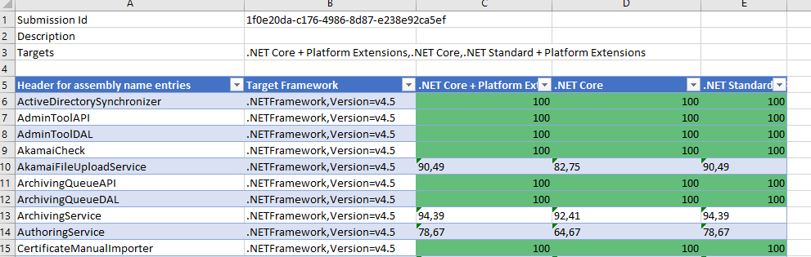
What I have to done, to have a succesful migration (It is not easy)
Steps:
.NET Portability Analyzer
The .NET Portability Analyzer is a tool that analyzes assemblies and provides a detailed report on .NET APIs that are missing for the applications or libraries to be portable on your specified targeted .NET platforms
1
.NET Portability Analyzer MSDN: Link
.NET Portability Analyzer Visual Studio Extension: Link

Slide 5
What I have to done, to have a succesful migration (It is not easy)
Steps:
Convert referenced libraries to .NET Core or to .NET Standard
Review 3rd party NuGet packages for .NET Core/.NET Standard support
(If you use Nuget packages in your project, check whether they are compatible with .NET Core.)
Check for .NET Standard compatibility
2

Slide 6
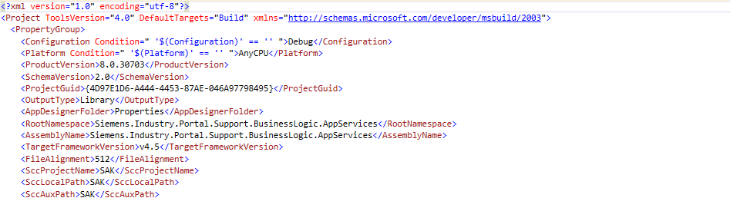
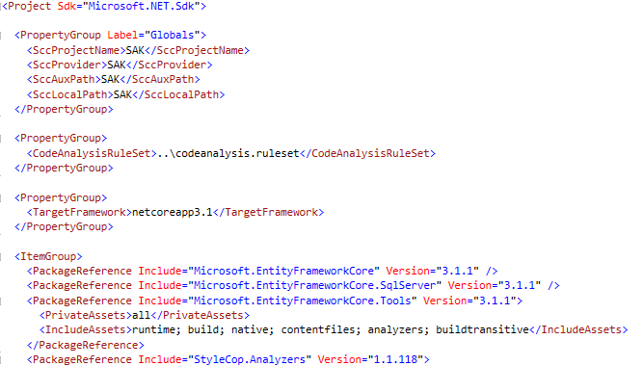
What I have to done, to have a succesful migration (It is not easy)
Steps:
Migrate to the new .csproj format (Using CsprojToVs2017 too could be helpful)
3
.hvannakel‘s CsprojToVs2017 Tool: Link

Slide 7
What I have to done, to have a succesful migration (It is not easy)
Steps:
4
Delete all uses of System.Web and replace them with Microsoft.AspNetCore.
5
Configure the Startup.cs file instead of using Global.asax.cs
Configuring middleware for MVC and WebAPI requests
Configuring for: Exception Handling
MVC Routing (Link)
MVC/WebAPI filters (Link)
Areas (Link)
Authentication/Authorization (Link)
CORS – Cross Origin Resource Sharing (Link)
…
6
Migrate HTTP handlers and modules to ASP.NET Core middleware (Link).

Slide 8
What I have to done, to have a succesful migration (It is not easy)
Steps:
7
Use Built-in Dependency Injection (automatic assembly scan with Scrutor, or Autofac)
8
Consider WebAPI Compatiblity Shim (Nuget Link)
Adds ApiController type
Enables WebAPI-style model binding
Extends modle binding so that controller actions can take parameters of type HttpRequestMessage
Adds message formatters allowing actions to return results of type HttpResponseMessage
9
Migrate Application Configuration into appConfig.json
10
Remove any HttpContext references (e.g.: HttpContext.Current does not exist at all, use HttpContextAccessor instead)

Slide 9
What I have to done, to have a succesful migration (It is not easy)
Steps (Others):
11
Move Static Content under wwwroot
12
Port EntityFramework References to EF Core
> dotnet ef dbcontext scaffold "ConnectionString" Microsoft.EntityFramework.SqlServer -o Model
13
Update Authenticaion and Authorization
14
JavaScript / CSS Updates
15
Migrate views

Slide 10
References
Migrate your existing ASP.NET application to ASP.NET Core - BRK3180 (Link)
Jeffrey T. Fritz – or simply “Fritz” is a Program Manager for Microsoft on the ASP.NET and .NET Community Outreach teams.
Scott Hansleman – Web Developer - LIVE: Upgrading an older .NET SDK to .NET Core and .NET Standard (Link)
Scott Hanselman is a Web Developer, works in Open Source on ASP.NET and the Azure Cloud for Microsoft out of his home office in Portland, Oregon

